Slide 1

ONLINE PLANT NURSERY APPLICATION
Presented by (Group-5):
1) Amajala Sri Ram Pavan
2) Jittiga Sri Harsha
3) Kakileti Mukunda Naga Saipriya
4) Mandala Mrudula
BATCH:
CAMP JR-30

Slide 2
CONTENTS
Problem Statement
Technologies
Modules
Project Structure in Visual Studio
Code Structure in Visual Studio
Models of Web pages
Benifits
Conclusion

Slide 3
PROBLEM STATEMENT
To Create an Application for Online Plant Nursery Application
Customer should be able to view the list of Plants , Seeds , Planters.
Customer should be able to buy order desired plants, seeds, planters.
Admin should be able to perform below operations:
Plants Management
Seeds Management
Planters Management
Customer Management

Slide 4
TOOLS/Technologies
HTML
CSS
React
Java Script

Slide 5


HTML:
HTML stands for Hyper Text Markup Language.
HTML is the standard markup language for creating Web pages.
HTML describes the structure of a Web page.
The Current version is HTML 5.
CSS:
CSS stands for Cascading Style Sheets
CSS describes how HTML elements are to be displayed on screen, paper, or in other media
It can control the layout of multiple web pages all at once
External stylesheets are stored in CSS files

Slide 6


React:
React allows developers to create large web applications that can change data, without reloading the page.
The main purpose of React is to be fast, scalable, and simple. It works only on user interfaces in the application
Java Script(JS):
JavaScript is the Programming Language for the Web.
JavaScript can update and change both HTML and CSS.
JavaScript can calculate, manipulate and validate data.

Slide 7
MODULES
Login Module
Customer Module
Plants Management Module
Seeds Management Module
Planters
Management Module
OrderBooking Management module

Slide 8
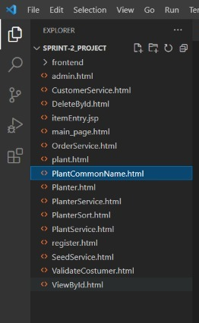
Project Structure in Visual Studio

Slide 9
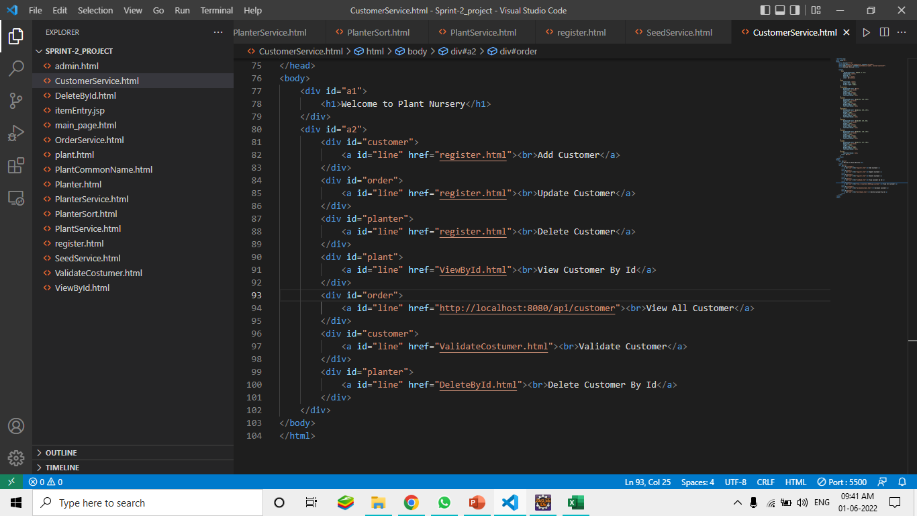
code Structure in Visual Studio

Slide 10
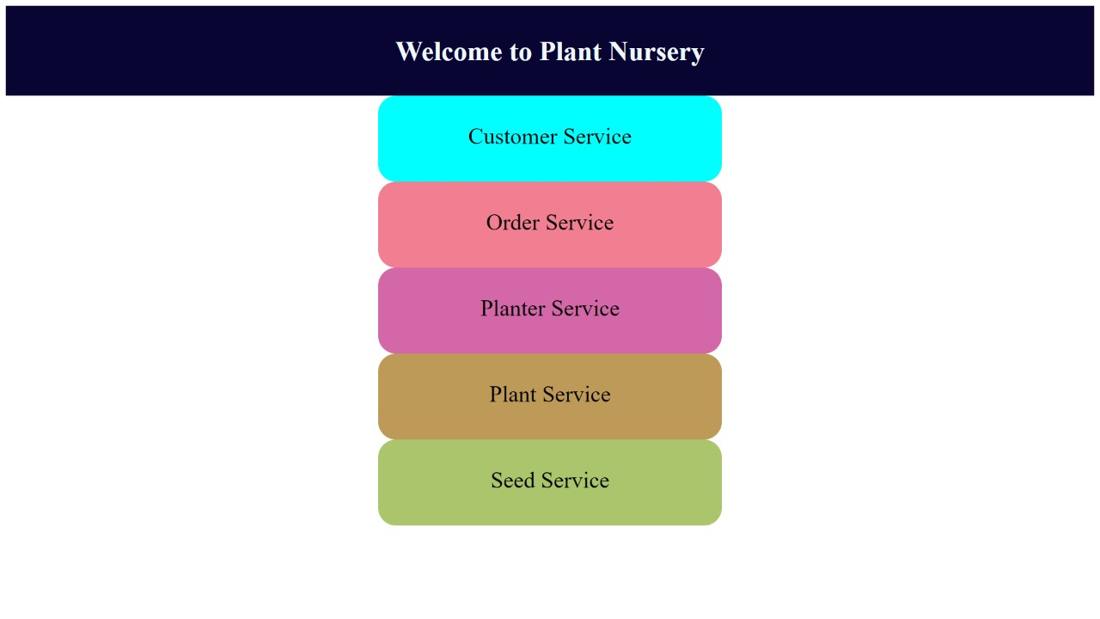
MODELS OF WEB PAGES
Home Page:

Slide 11
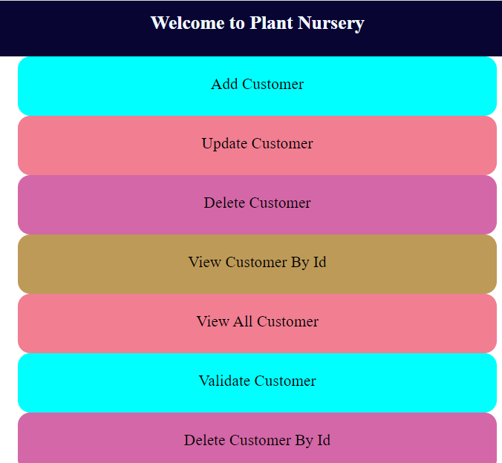
Customer service:

Slide 12
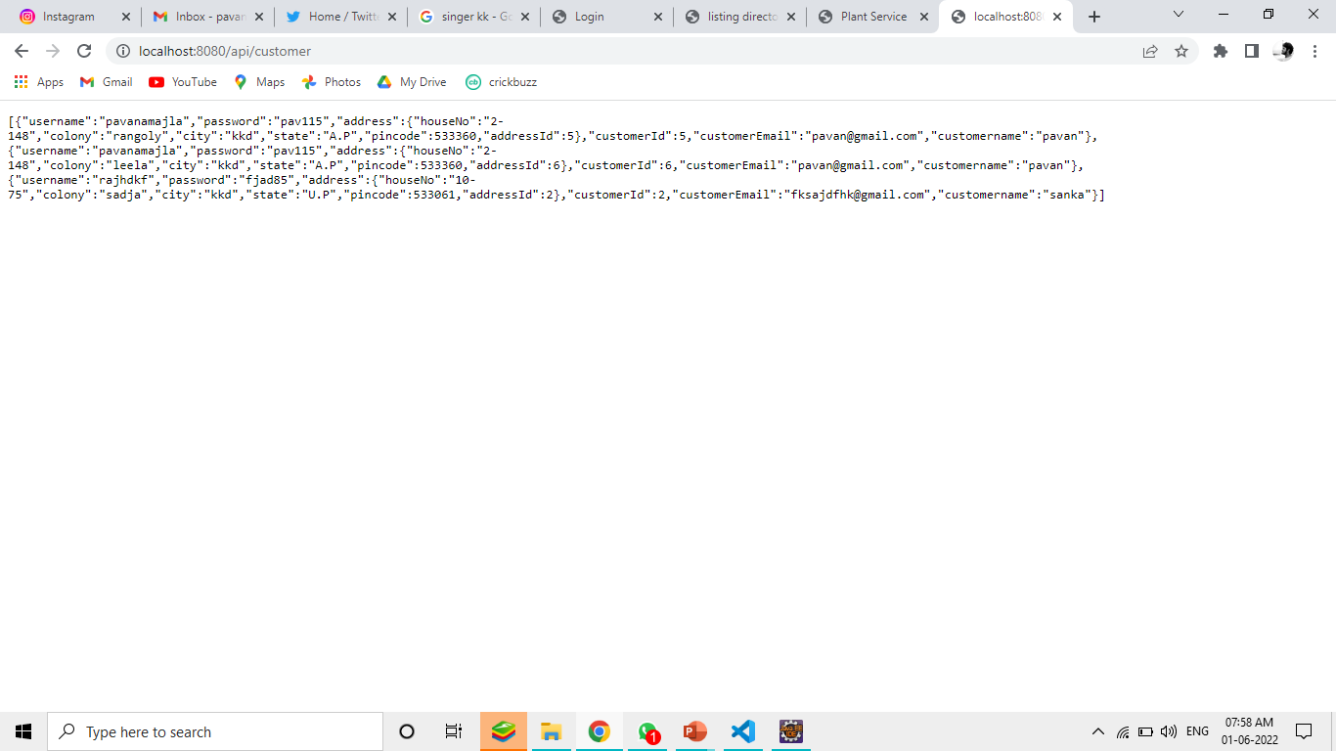

Slide 13
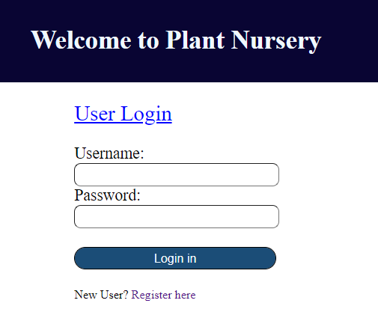

Slide 14
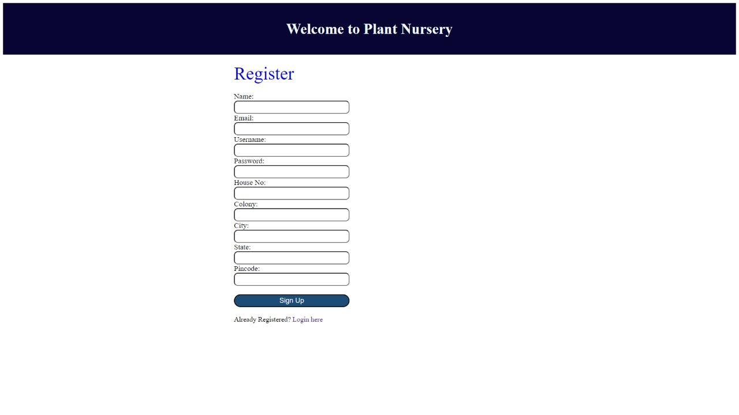
Registration Form:

Slide 15
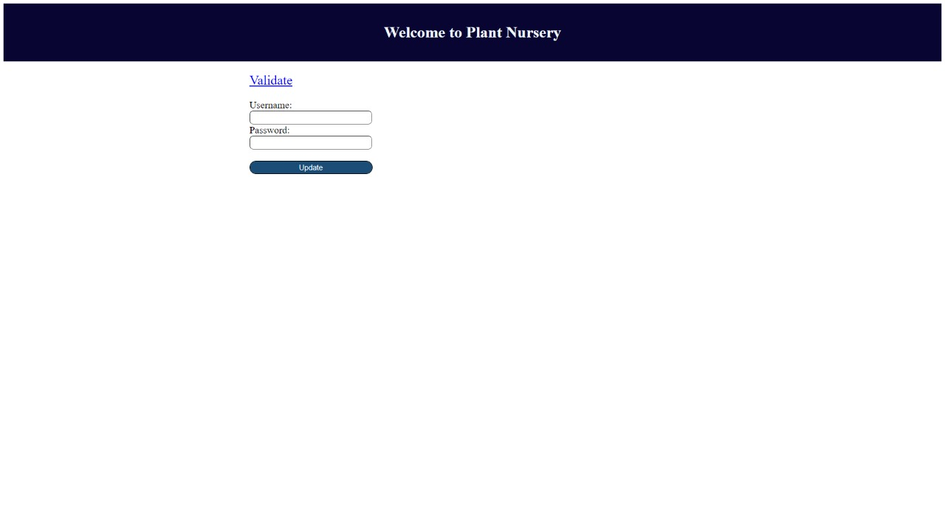

Slide 16
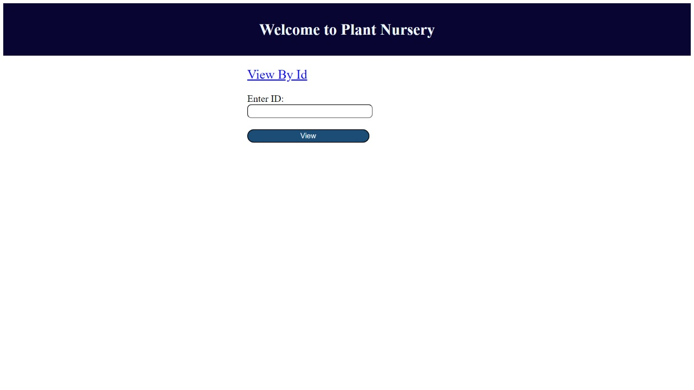

Slide 17
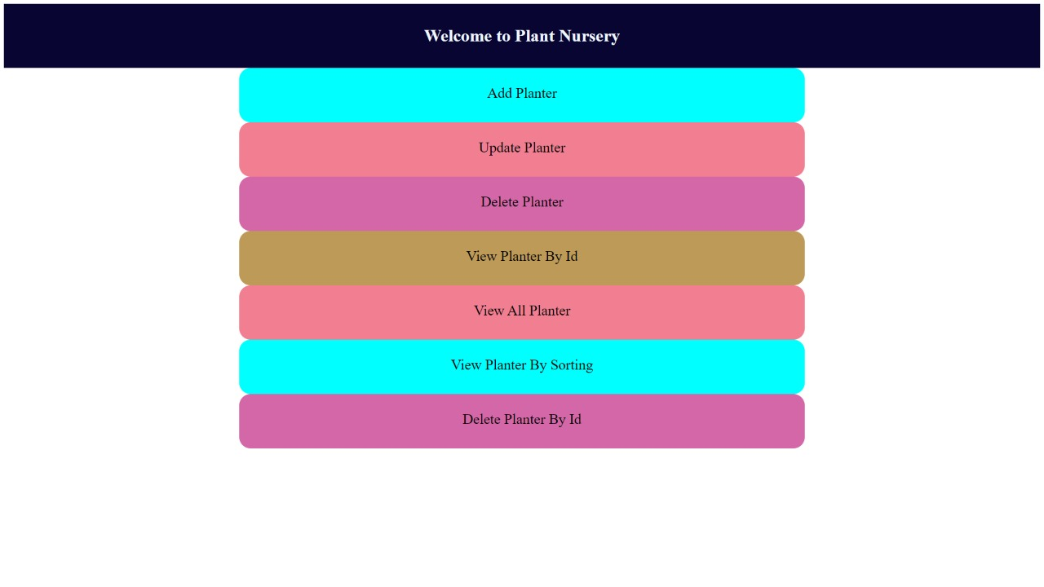

Slide 18
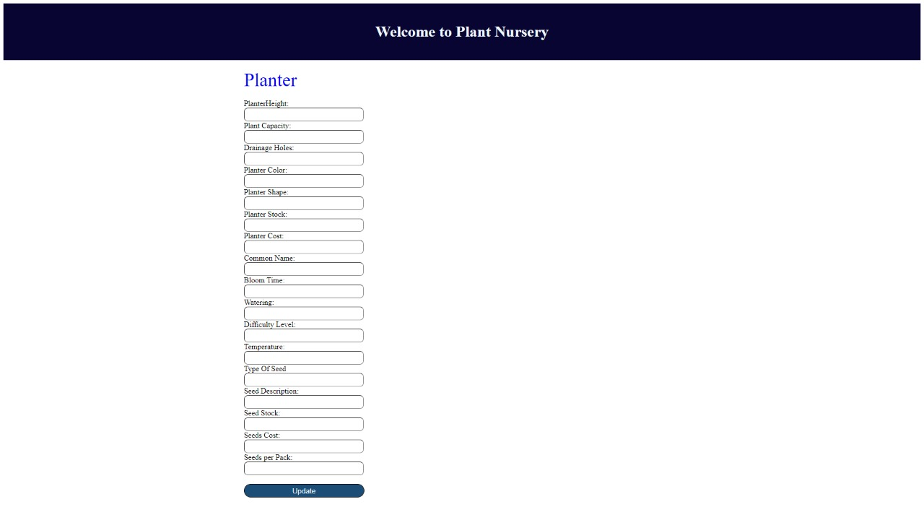

Slide 20


Slide 21
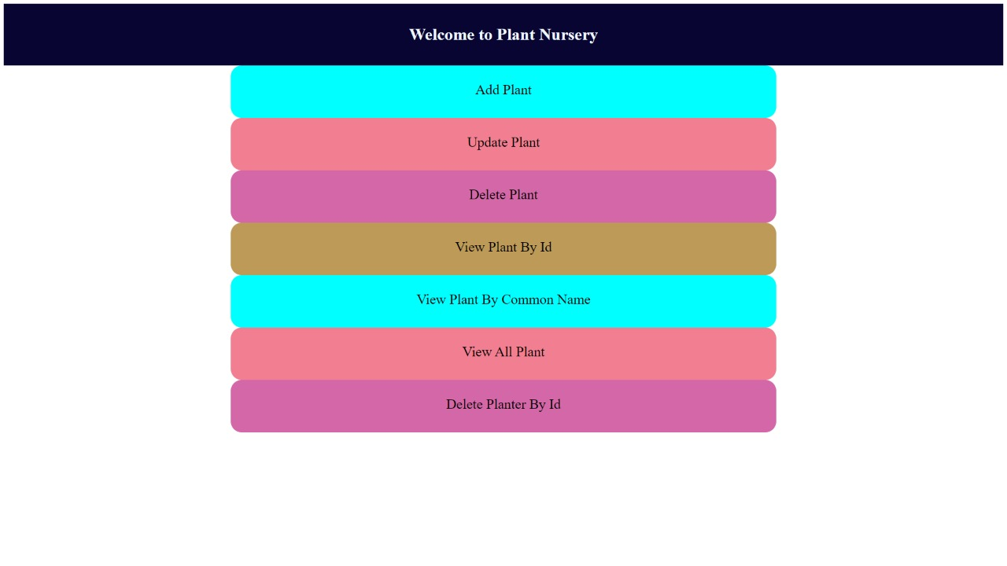

Slide 22
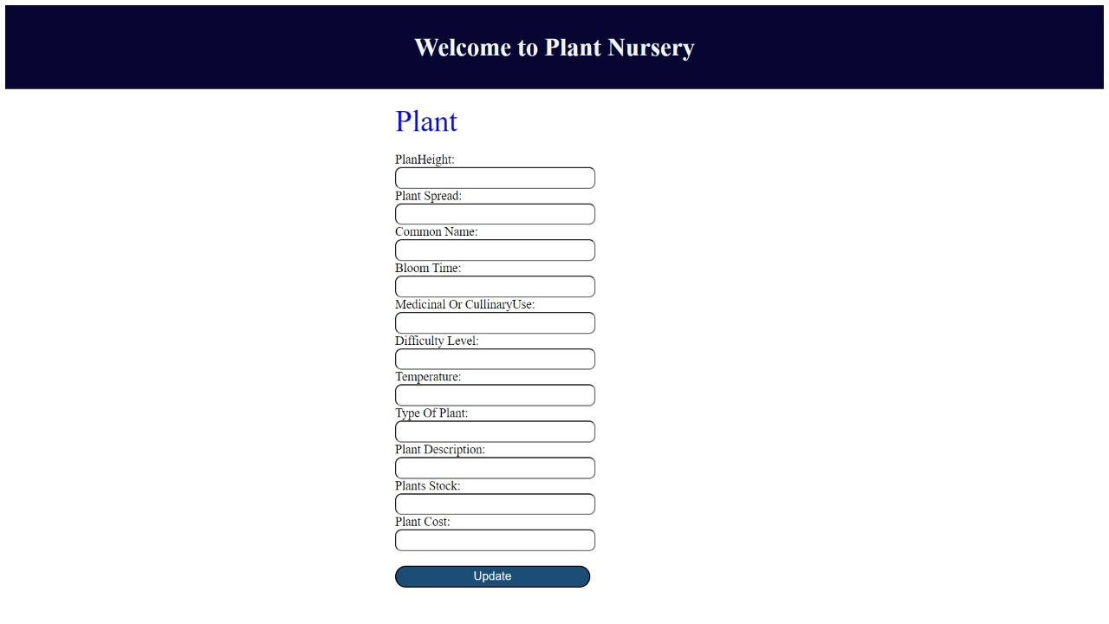

Slide 23
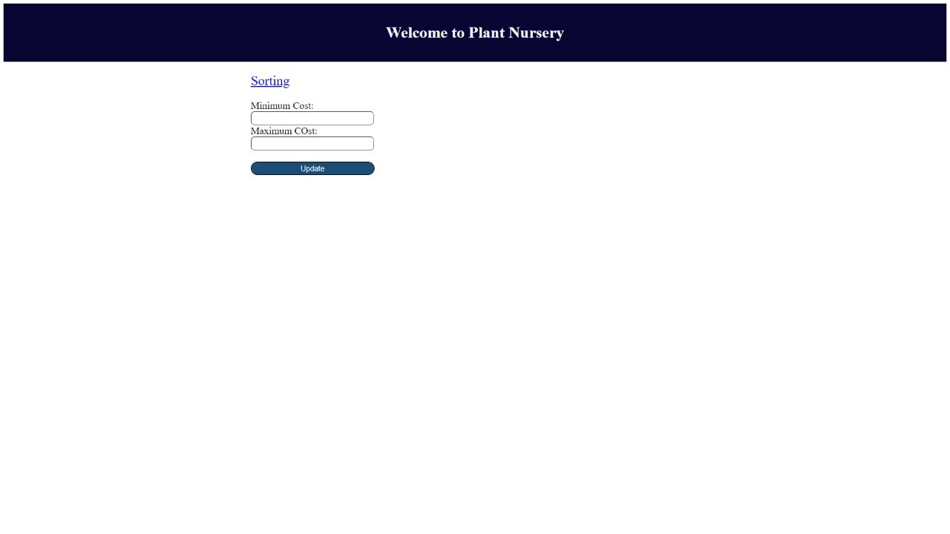

Slide 24
BENIFITS
Being able to buy anytime, anywhere, any place.
Site enables them to browse before they shop, and to research the product so they have more confidence in what they are buying.
Even though online shopping sites are having affordable rates, the offers and discounts will further reduce the cost of the indoor plants.

Slide 25
CONCLUSION
A nursery is a place where plants are spread and grown to usable size.
By using online plant nursery application some retail and wholesale nurseries can be sold by means of E-business.
The proposed system can guarantee to keep the records are safe and privacy which is stored in the database.
It converts unstructured data into structured data and sorted format.

Slide 26


